Slide 1
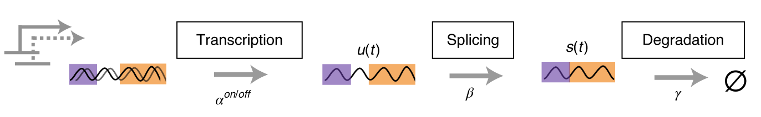

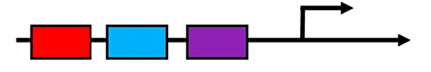
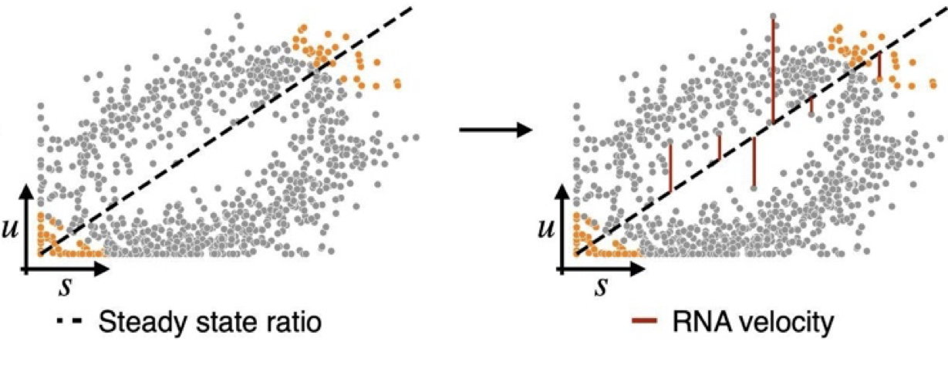

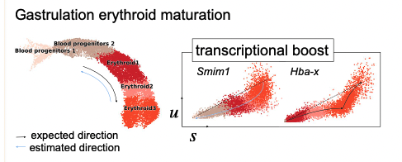

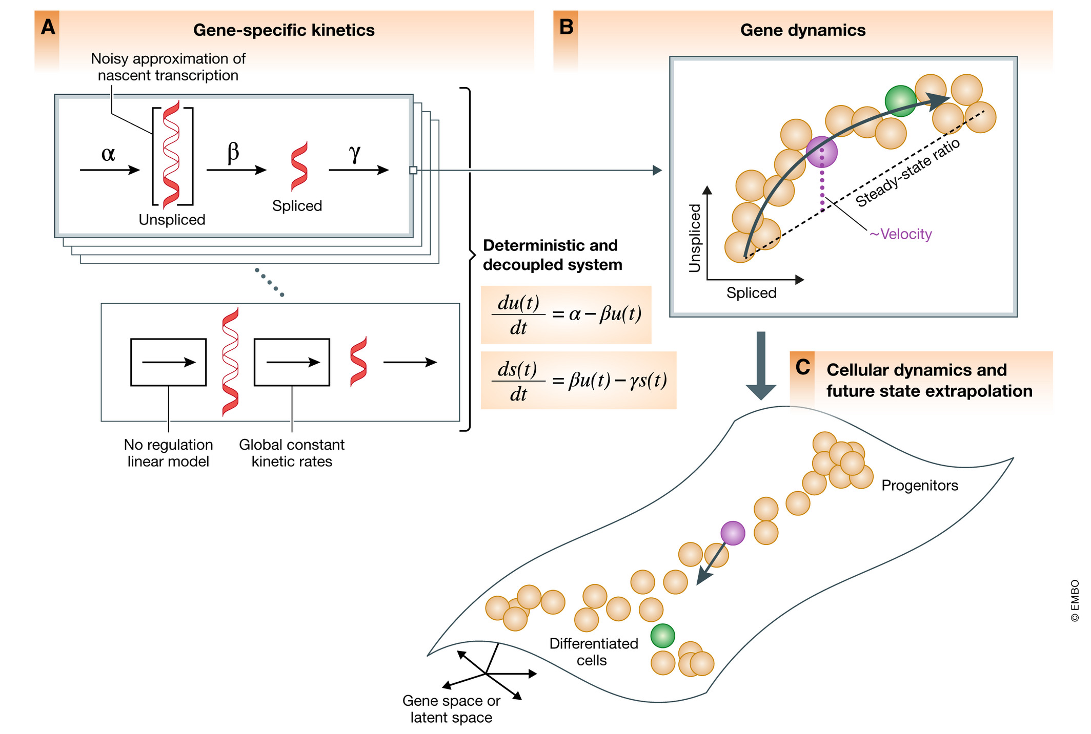
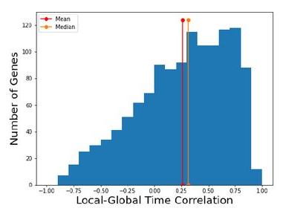
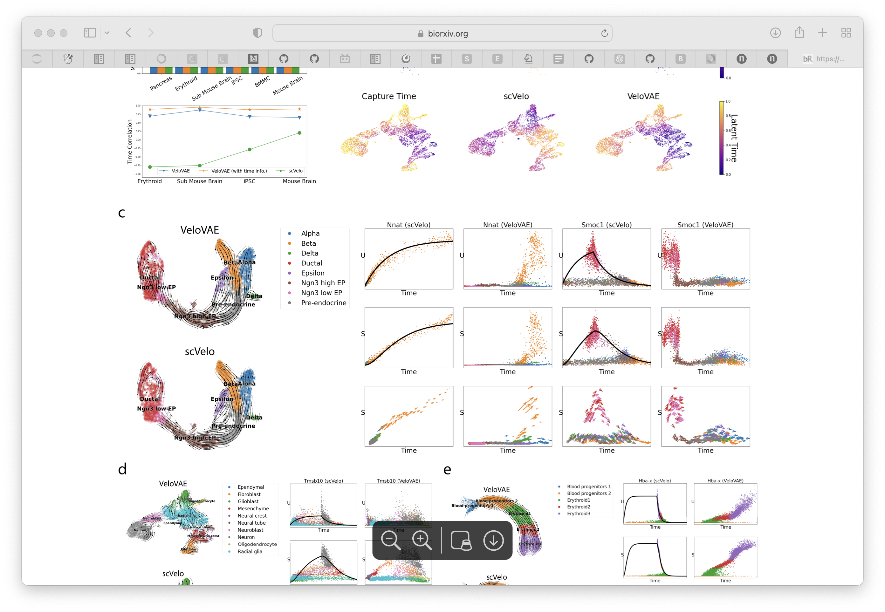
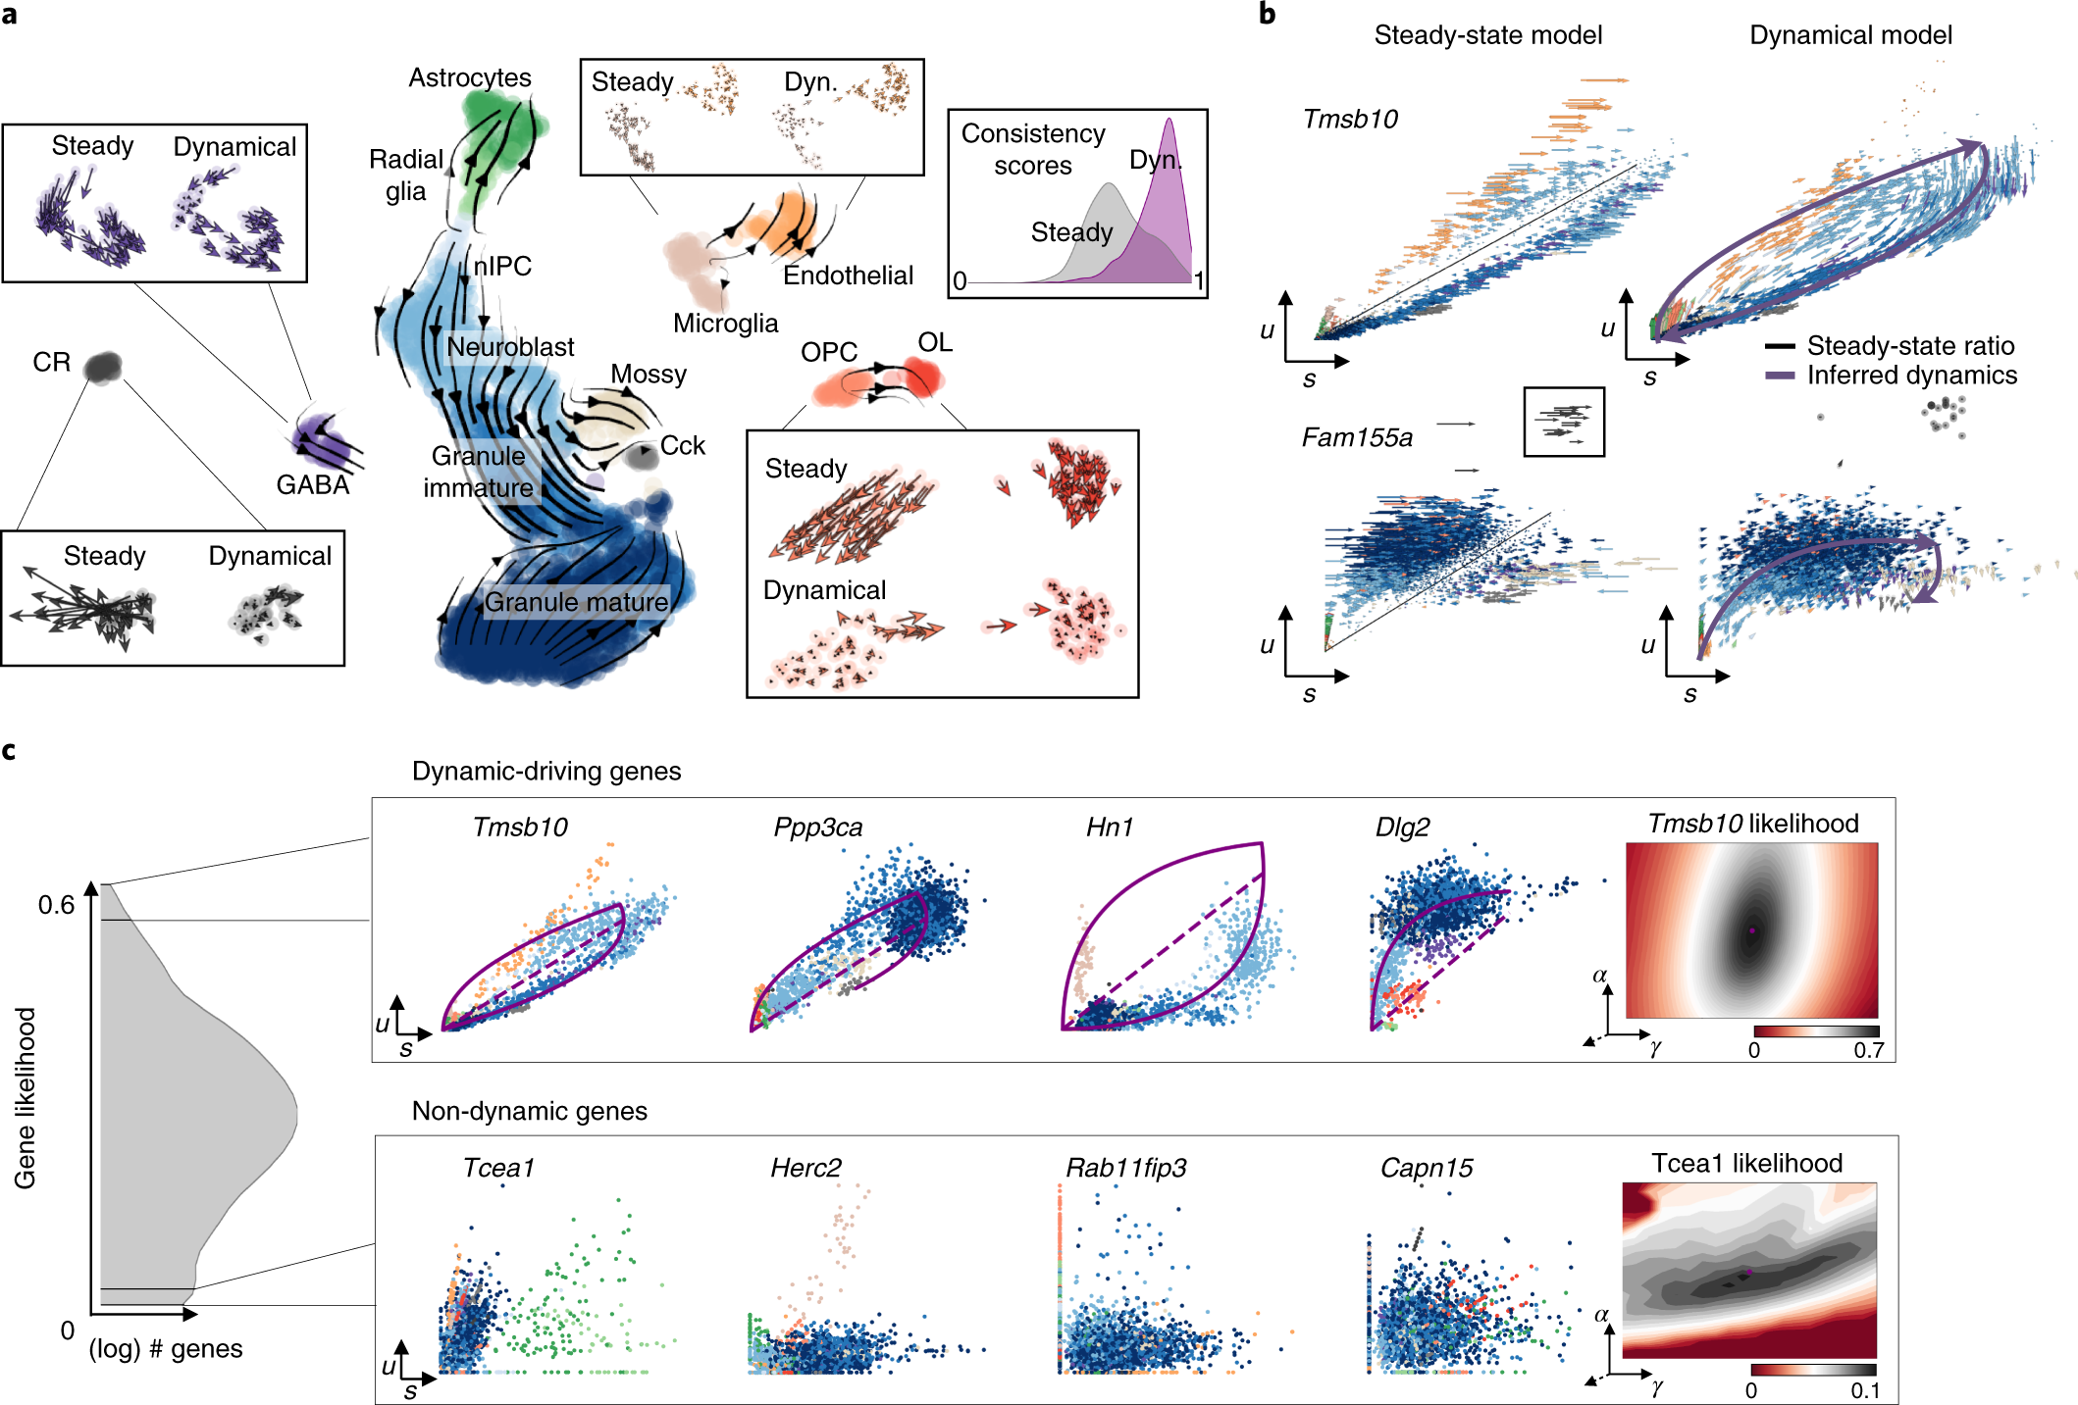

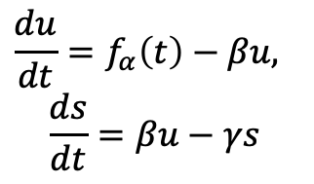


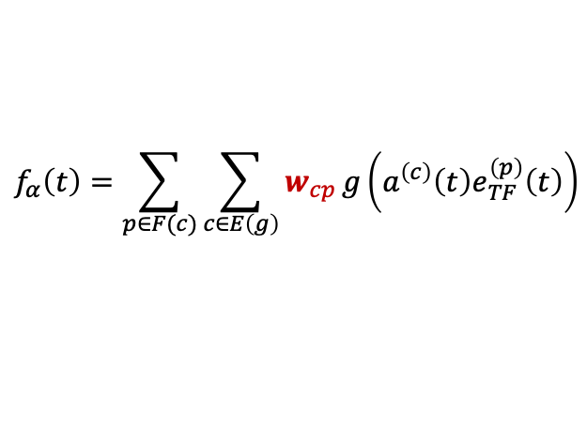

Current limits in RNA velocity
Multivariate Models towards systems dynamics (RegVelo)
TF2
Modeling the regulatory dynamics of target gene
TF1
$$α$$
$$β$$
$$γ$$
$$\frac{du}{dt}=f_{α}\left(t\right)−βu,$$
$$\frac{ds}{dt}=βu−γs$$
1. Steady state assumption
2. Generalized transient system
CRE1
CRE2
CRE3
Target genes
$$f_{α}\left(t\right)=\sum_{p∈F(c)}{\sum_{c∈E\left(g\right)}{w_{cp}}g\left(a^{\left(c\right)}\left(t\right)e_{TF}^{\left(p\right)}\left(t\right)\right)}$$
La Manno, et al. 2019, Weiler, et al. 2022
Bergen, et al. 2020
Transcriptional bursting induced by change of transcription rate
TF: Transcription Factor
CRE: cis-regulatory elements
Supervised by: Marius & Fabian
Potential application of RegVelo
Bergen, et al. 2021
1. A better velocity estimation and fate probability prediction
later induction
First induction
“First induction” ->
Gene specific latent time -> a heuristic estimation of global latent time
2. Understanding the underlying regulatory mechanisms of lineage differentiation/priming
Gu, et al. 2022
Each gene fit independently, ignoring everything about regulation relationship
3. Generate new trajectory and test the effects of TF-perturbation the lineage differentiation.
Gu, et al. 2022

Slide 2
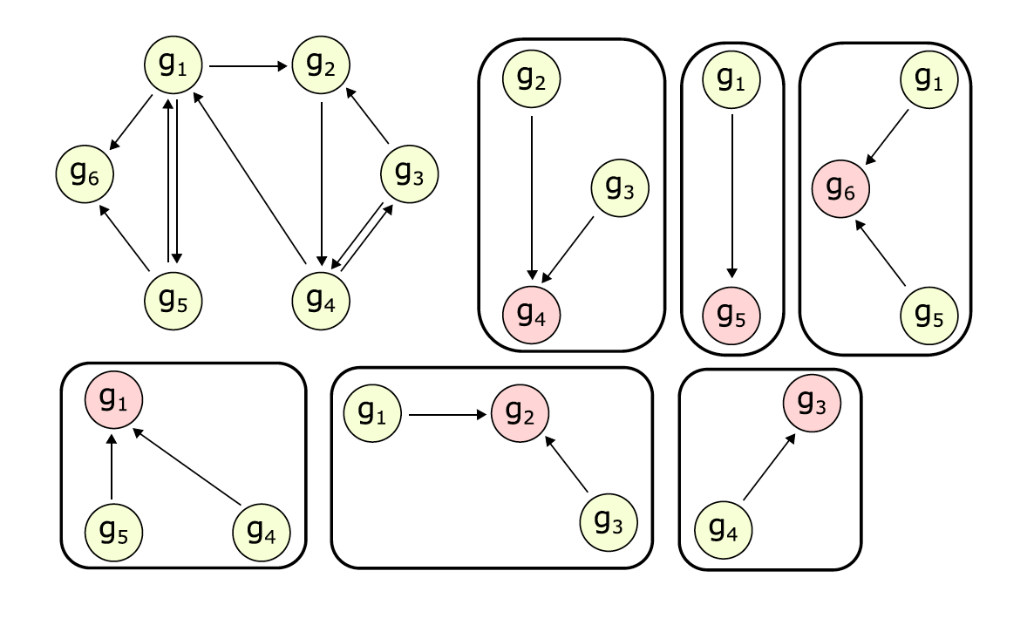
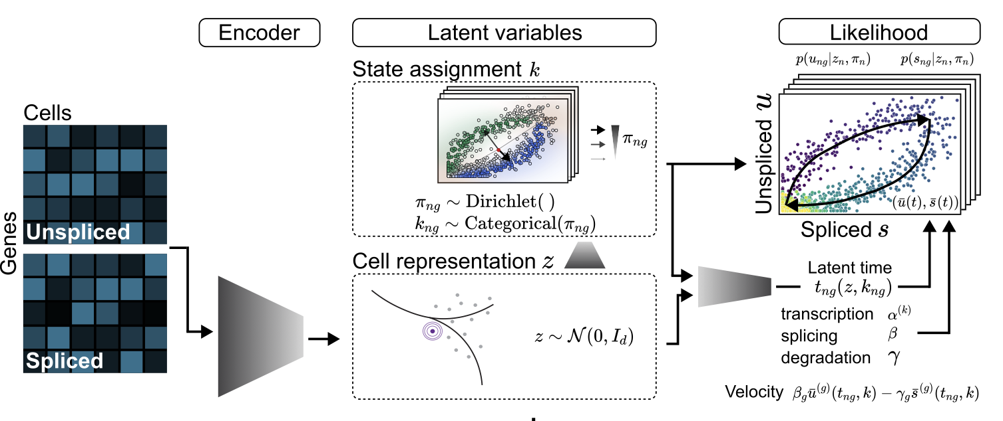
Appendix
Decouple the system using condition independence
Keypoints of estimation framework
1. A decoupled systems
Gene (velocyto, scVelo) -> Regulon (RegVelo)
2. Building on flexible VeloVI framework
Recap of VeloVI estimation framework
Decouple into “regulons”:
A target gene and a set of regulators(TF & CREs)
Georgoulas, et al. 2012
Estimation procedure:
1. Initialize using scVelo, velocyto (or MongeVelo?) to get the estimation of latent time.
2. Interpolate the dynamics of the regulators use top-down manner (emulators) using parametric function (RBF) or Gaussian process.
3. For each subsystem, estimate kinetic parameter and regulatory parameters
4. In the meantime, regularize the solution of regulator (TF and CRE) need to be same to the interpolation
5. Updating until converge.
Gayoso & Weiler, et al. 2022

